Slide 1
Discord Tournament Bot Milestone 1 Report
Lily Lama-Solet, Shane Wild, Brandynn Daugherty, Grant Richardson, Jonathan Pass

Slide 2
Agenda
Summary
Milestone Assessment
Planning and Tracking Review
Future Plan

Slide 3
Milestone 1 Objectives
Create a Discord bot capable of joining/leaving servers.
Bot is to be used in KSU esport’s in-house tournaments.
Develop the bot’s admin commands for tournament check-ins and server moderation.
Develop the bot’s buttons to allow users to check-in, leave, volunteer out, or rejoin tournament matches.

Slide 4
Milestone 1 Summary
On schedule to complete all objective requirements.
Status of Milestone 1 objective requirements:
Bot join/leave server capability.
Bot admin commands.
Bot user-friendly buttons.

Slide 5
Milestone 1 Phases
Research basic Discord bot fundamentals, commands, and buttons.
Create the bot and invite it into test server.
Develop admin commands for tournament moderation.
Develop user-friendly buttons to ease tournament player check-ins.

Slide 6
Bot Commands
Multiple admin commands used for tournament check-ins or moderation.
Check-in: Allow players to check into or leave a tournament.
Re-check: Allow players to volunteer to sit out or rejoin a tournament.

Slide 7
Bot Buttons
Buttons used conjointly with tournament commands.
Check-in command:
Check-in: Allow players to check into a tournament.
Leave: Allow players to leave a tournament.
Re-check command:
Volunteer: Allow excess players to sit out of tournament.
Re-join: Allow players to rejoin a tournament to fill a game lobby.

Slide 8
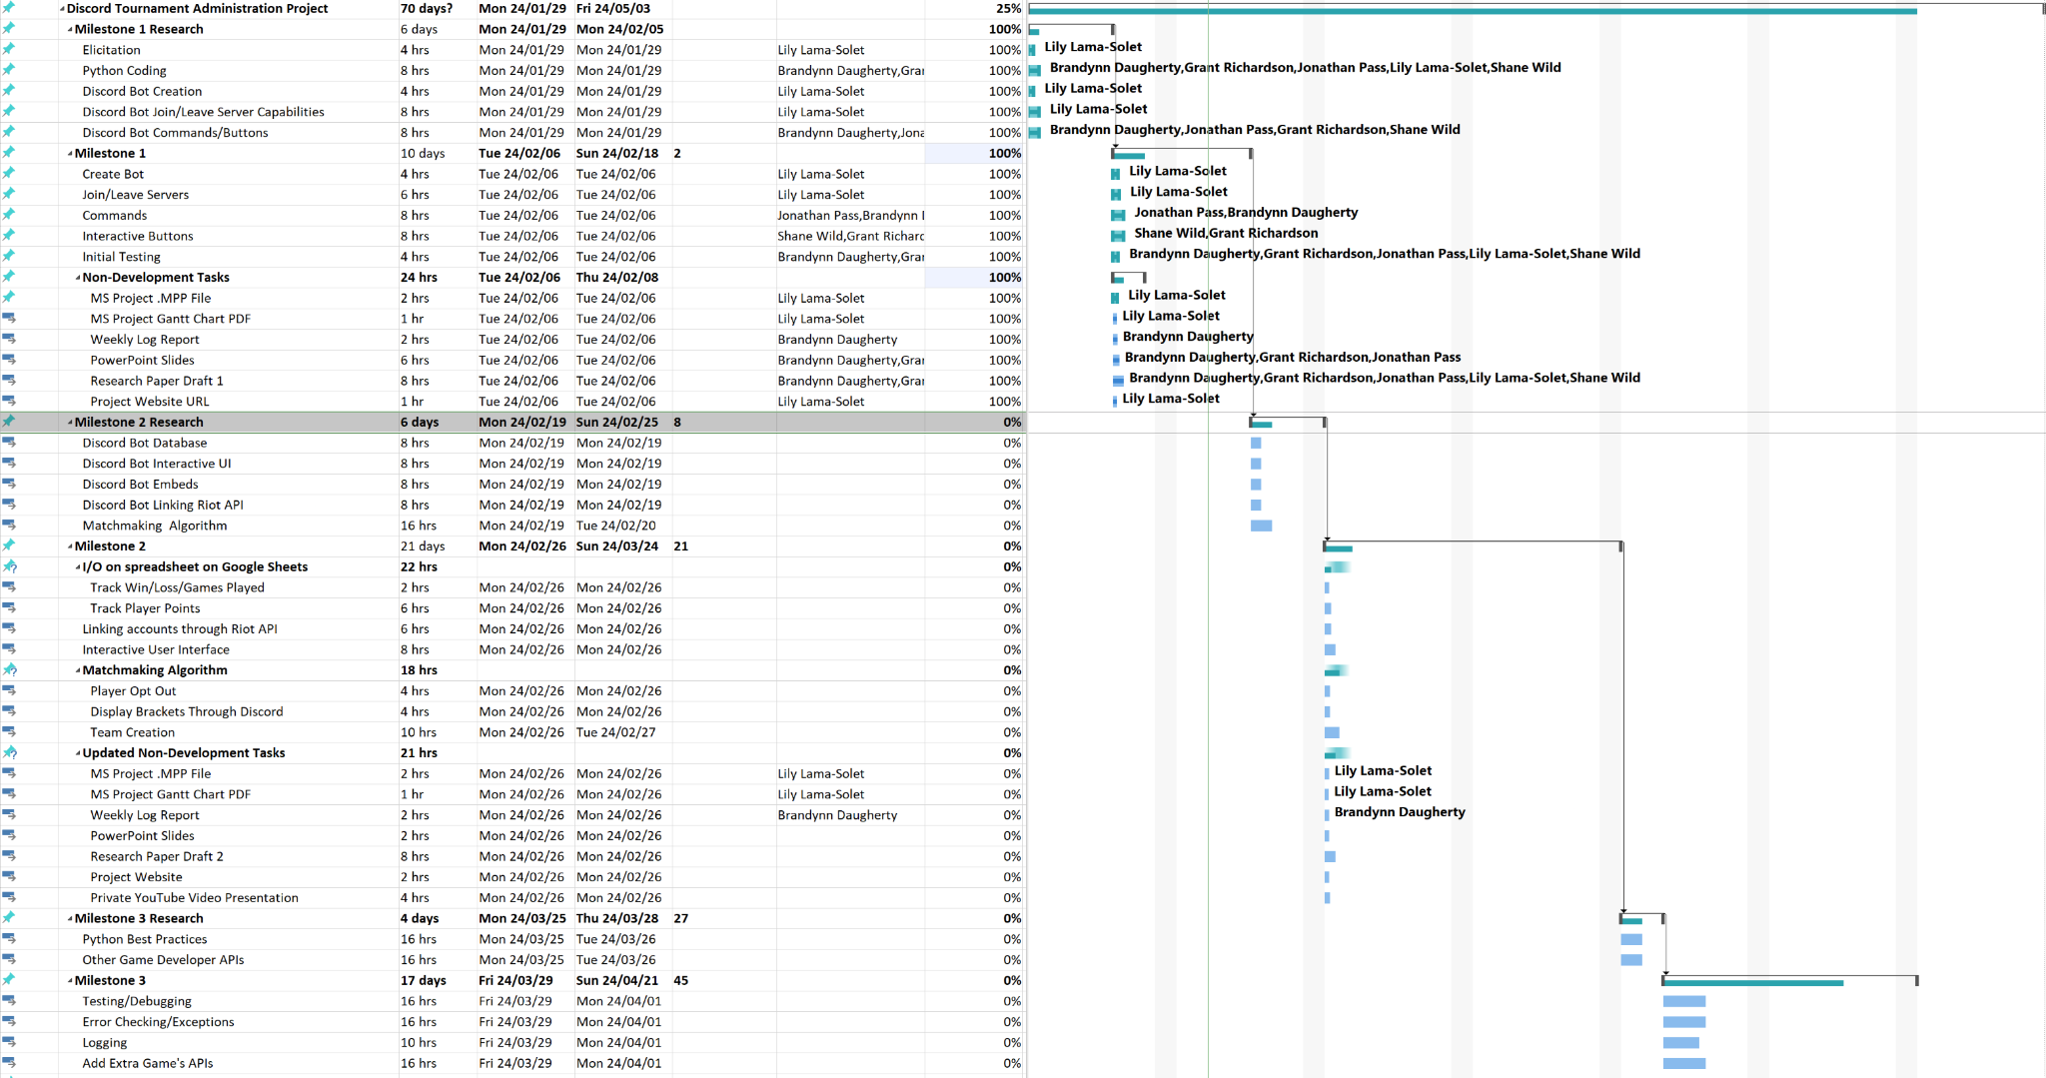
Gantt Chart

Slide 9
Member Contributions
Lily Lama-Solet
Project Management
Helped Develop the buttons and bot
Brandynn Daugherty
Weekly Reports
Helped Develop the buttons

Slide 10
Member Contributions cnt.
Grant Richardson
Wrote the draft of the research paper
Helped testing the bot
Shane Wild
Helped make and test the bot
Setup the basic website template
Jonathan Pass
Helped make and test the bot
Helped with presentation

Slide 11
Milestone 2 Preparation
Link Discord bot to Google Sheets.
Code bot to read/write to the spreadsheet.
Develop UI to display teams for both lobbies and for tournament results.

